Slide 1

論文報告
楊秉宇

Slide 2
Topic
論文主題: Digging into HTTPS: Flow-Based Classification of Webmail Traffic
論文出處:10th ACM SIGCOMM Conference on Internet Measurement
年代: 2010

Slide 3
Outline
The main goal of this paper
Data set
How to select feature
How to process Classification
Evaluation
Related work
Conclusion

Slide 4
Problem Background
Internet users prefer to access their e-mail via a web-based (webmail) interface
Detrimental for the field of Internet traffic classification
Flow-based features are not sufficient to classify individual HTTPS flows as webmail or not.
`

Slide 5
Main Goal
Use novel features for HTTPS webmail classification
Not to maximum accuracy
Proof that novel features is general feasibility

Slide 6
Some thinking to solve the problem
Webmail servers tend to reside in the vicinity of legacy SMTP, IMAP, and POP servers
Webmail traffic exhibits pronounced periodic patterns

Slide 7
the data set
NetFlow traces coming from SWITCH
5-tuple (source address and port, destination address and port, transport protocol identifier)
2010-03-15 the 500 most popular internal HTTPS hosts/sockets

Slide 8
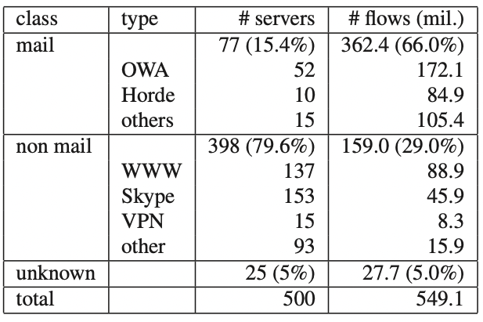
top500 information

Slide 9
feature select
Service proximity
Daily and weekly profile
Session duration
Periodicity

Slide 10
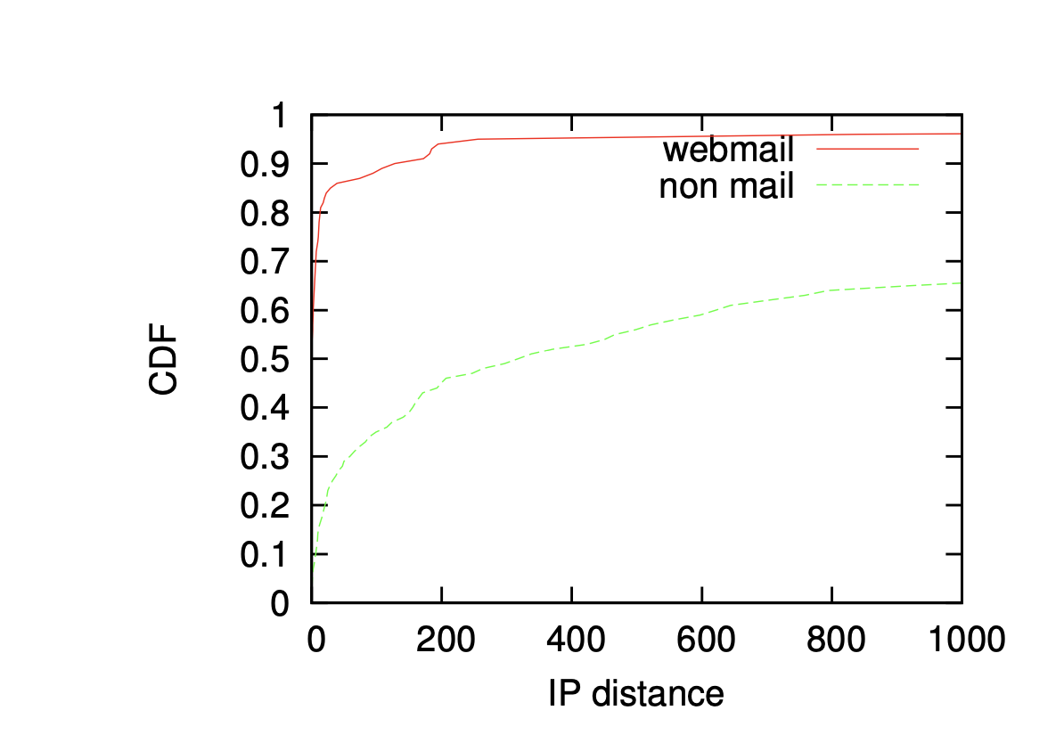
Service proximity
High chance to find a webmail server in the same subnet
Almost 60% of the webmail servers have a distance to 1 IP
90% of the webmail servers have a distance smaller than 200 IP addresses

Slide 11
Service proximity
These numbers indicate that webmail servers are substantially more likely than non-mail servers to be in the neigh- borhood of a legacy mail server.

Slide 12
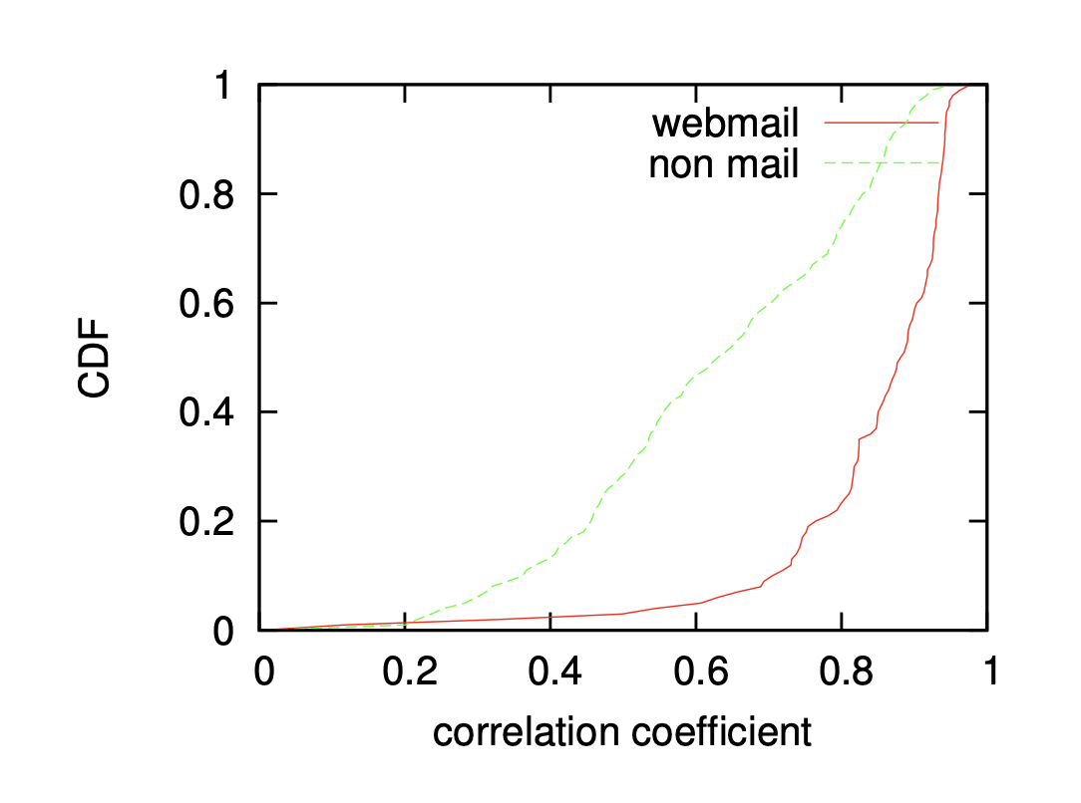
Daily and weekly profile
IMAP and POP duranl and weekly patterns will be more similar to webmail than to non-mail server patterns.
Partition the time that one bin for one hour.
Count the number of sessions with two sessions of two servers.
Use Spearman’s coefficient to count correlations between the two vector

Slide 13
Daily and weekly profile
more than 90% of the webmail servers the correlation coefficient is higher than 0.6 while this per- centage is only about 50% for non-mail servers.

Slide 14
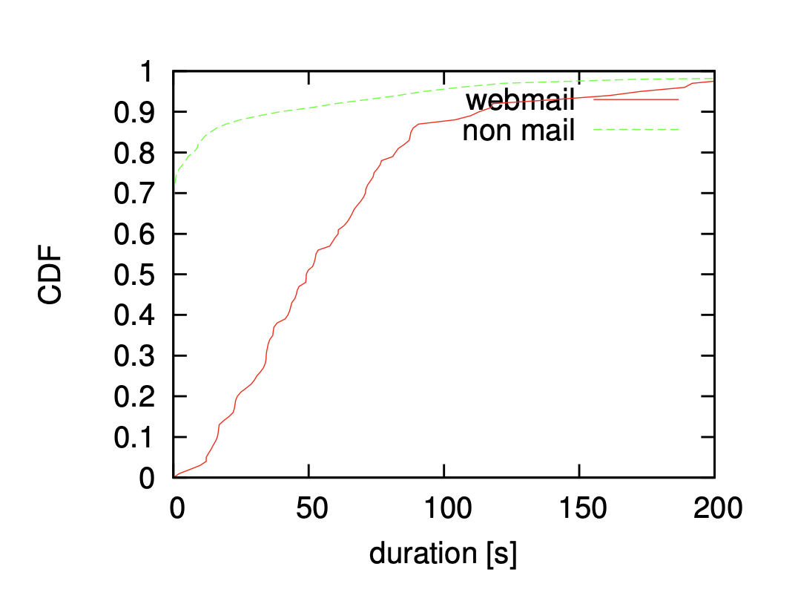
Session duration
Webmail users take some time to read and write their email. May keep the browser windon open to wait for incoming message
Duration for a webmail service should be higher.
20% session duration of webmail service shorter 25s.
90% session duration of non-webmail service shorter 25s.

Slide 15
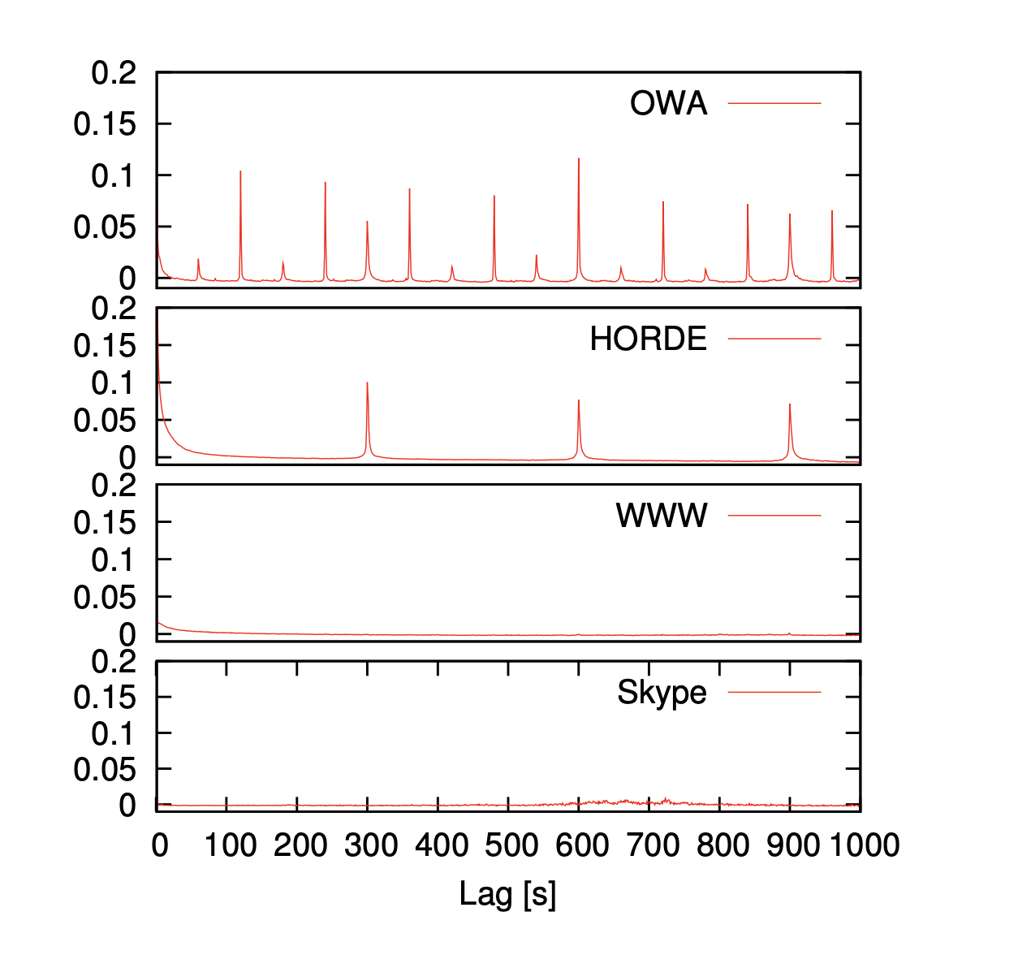
Periodicity
Webmail check periodically for incoming messages and update
Usiing Wireshark and Firebug analyze the webmail session.

Slide 16
Periodicity
Filtering out all short sessions
Keep all sessions and respective flows with a duration higher than 1, 800s(six 5-minute intervals)
Split each session into time bins of 1s and count the number of flows that start within a bin.
Compute the autocorrelation function and average the autocorrelation signals in order to smooth the signal and obtain a server-level behavior.

Slide 17
How to classify the HTTPS traffic
use the Support Vector Machine (SVM)
four features( service proximity, activity profiles, session duration, periodicity)
5-fold cross-validation

Slide 18
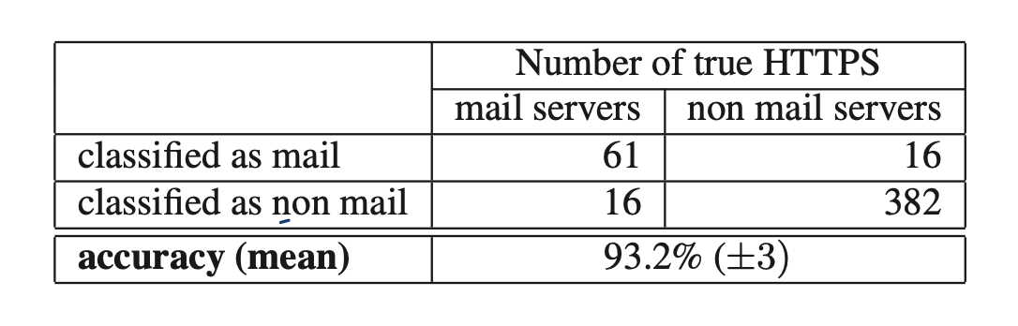
Classify Result-1
high mean accuracy of 93.2% (with standard deviation 3.0) across
the five runs of our 5-fold cross-validation

Slide 19
Another data to classify
Select another 500 data set
Merge with too500 data set
Total 1000 https servers
5-fold cross-validation.

Slide 20
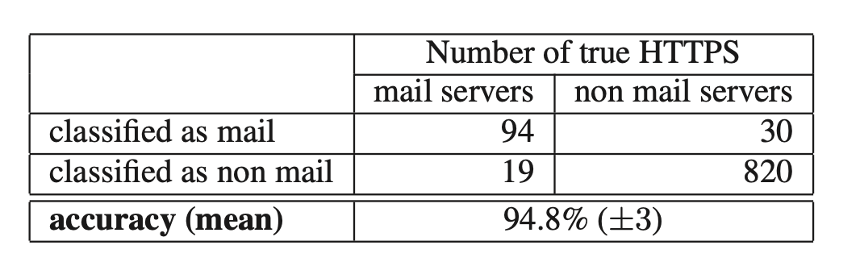
Classify Result-2
high mean accuracy of 94.8% (with standard deviation 3.0) across
the five runs of our 5-fold cross-validation

Slide 21
Conclusion
Effectively discriminate between web-mail and Skype(Feature 1)
Distinguish between VPN and web-mail servers is challenging
By experience HTTPS webmail can classify based on these novel feature.

Slide 22
Thank you for your attention

